Slide 1
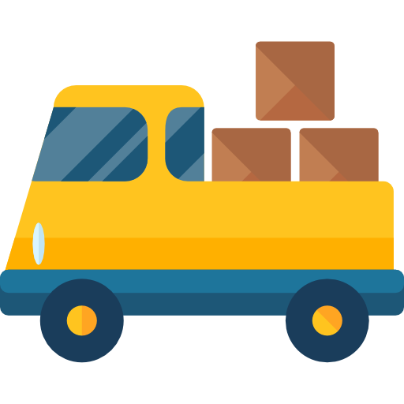

Logistics App
Team Members:
Gagan Saxena
Prakhar Srivastava
Rajeev Pachauri
Siddhant Bansal
Project Mentor:
Mr. Neeraj Khanna
Technical Trainer
C S E Dept.
GLA University, Mathura

Slide 2



 Project Objective
 What we learnt?
 Software Requirements
 End Users?
 Reference

Slide 3
 To develop an Interactive Android app which provides :
Project Objective
View the list of orders and detailed information on each.
Track and evaluate delivery progress.
Observe orders and estimated routes on the map.
Receive push-notifications on relevant events related orders, routes, and delivery process.
Make a detailed route to an order using external navigational applications.
.

Slide 4

Android Studio JAVA (Back End) XML (Front End) Google Firebase Firebase Real Time Database
Technical Learning
General Learning
Team Work

Slide 5
ANDROID STUDIO
Android Studio is the official integrated development environment for Google's Android operating system, built on JetBrains' IntelliJ IDEA software and designed specifically for Android development.
This increase the rate of production, and debugging is easy.

Slide 6
JAVA
Java is a programming language and a platform.
Java is a high level, robust, object-oriented and secure programming language.
An application which is created for mobile devices is called a mobile application. Currently, Android and Java ME are used for creating mobile applications.

Slide 7
XML (Extensible Markup Language)
XML stands for Extensible Markup Language. XML is a markup language much like HTML used to describe data. XML tags are not predefined in XML. We must define our own Tags. Xml as itself is well readable both by human and machine. Also, it is scalable and simple to develop. In Android we use xml for designing our layouts because xml is lightweight language so it doesn’t make our layout heavy.

Slide 8
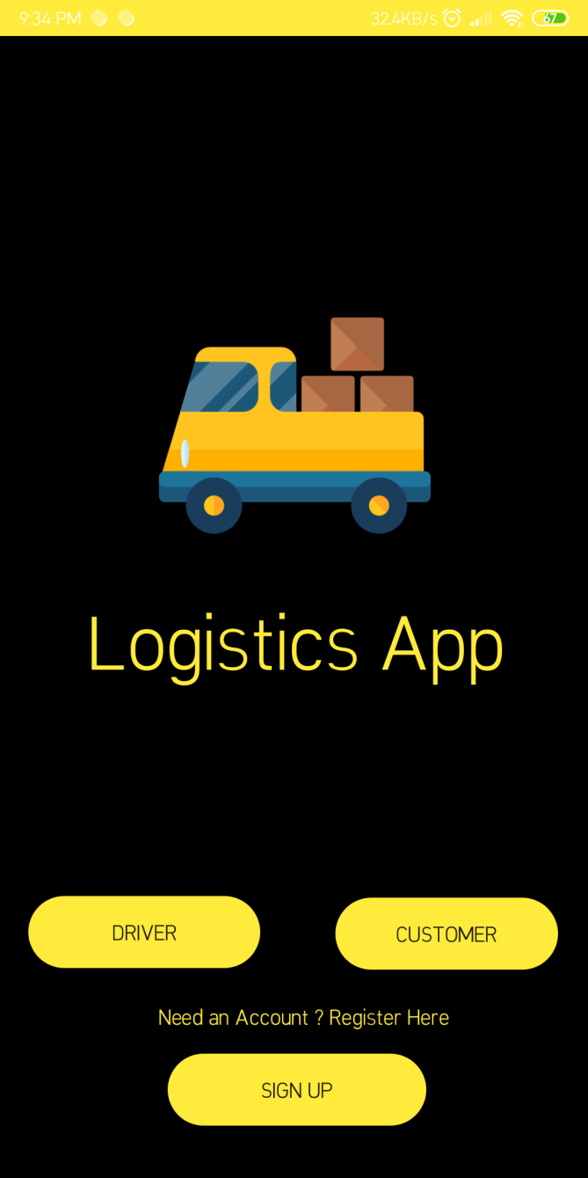
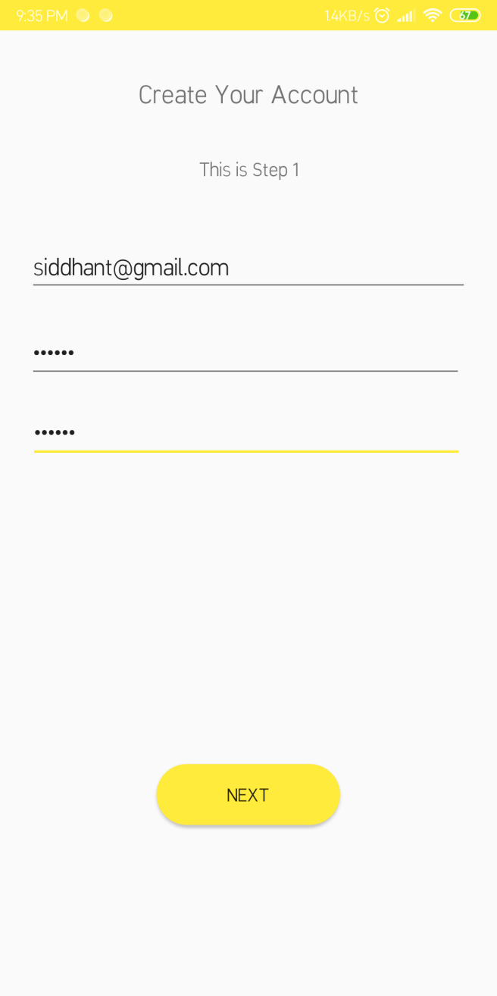
USER INTERFACE

Slide 9
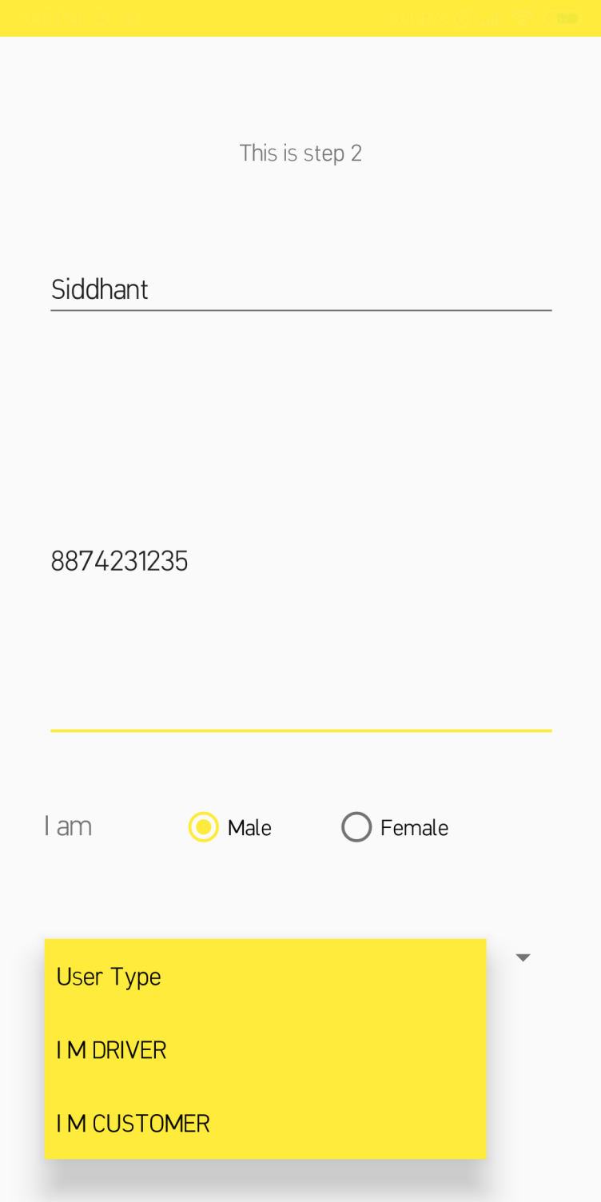
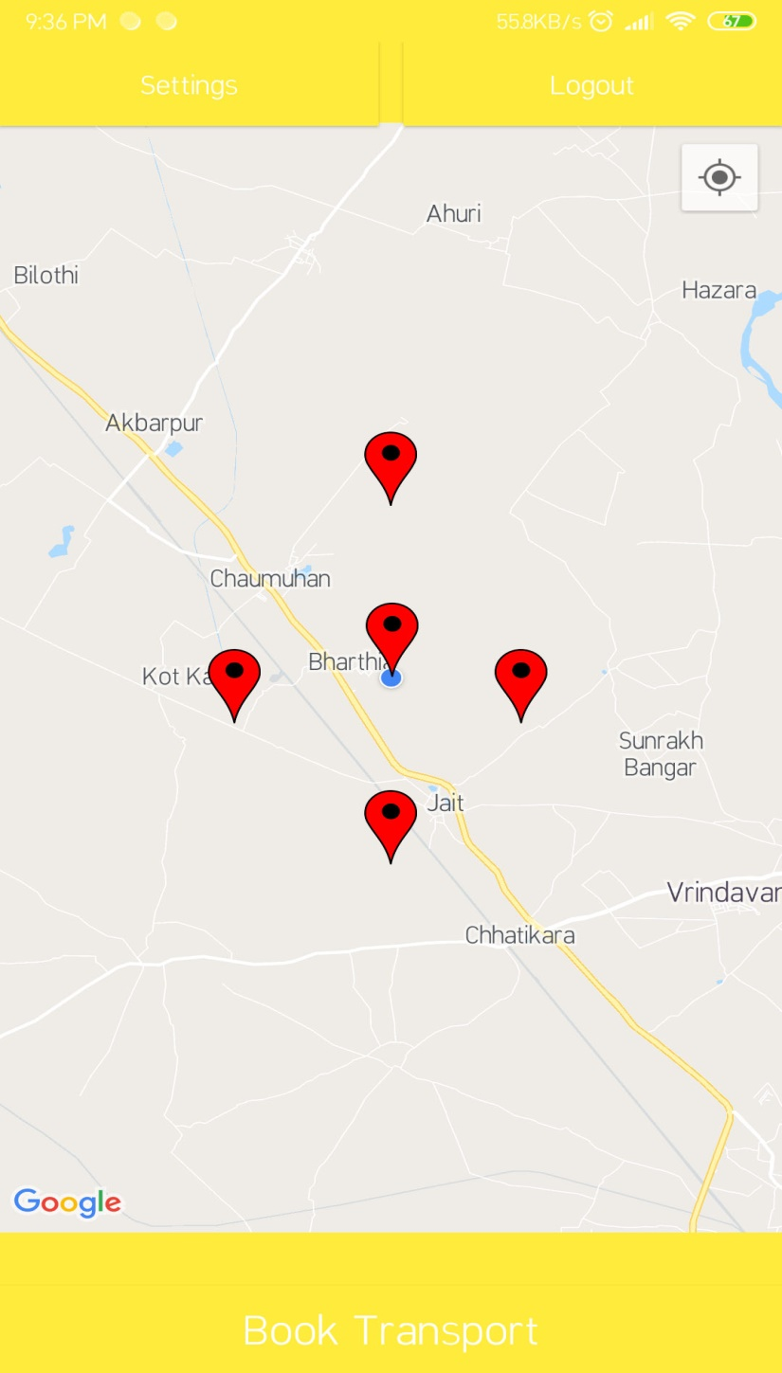

Slide 10
Google Firebase
Firebase is a mobile and web application development platform developed by Firebase, Inc. in 2011, then acquired by Google in 2014.As of October 2018, the Firebase platform has 18 products which are used by 1.5 million apps.
Services:-
Firebase Authentication
Realtime Database

Slide 11
Firebase Authentication
Most apps need to know the identity of a user. ... Firebase Authentication provides backend services, easy-to-use SDKs, and ready-made UI libraries to authenticate users to your app. It supports authentication using passwords, phone numbers, popular federated identity providers like Google, Facebook and Twitter, and more.
implementation 'com.google.firebase:firebase-auth:16.0.5'

Slide 12
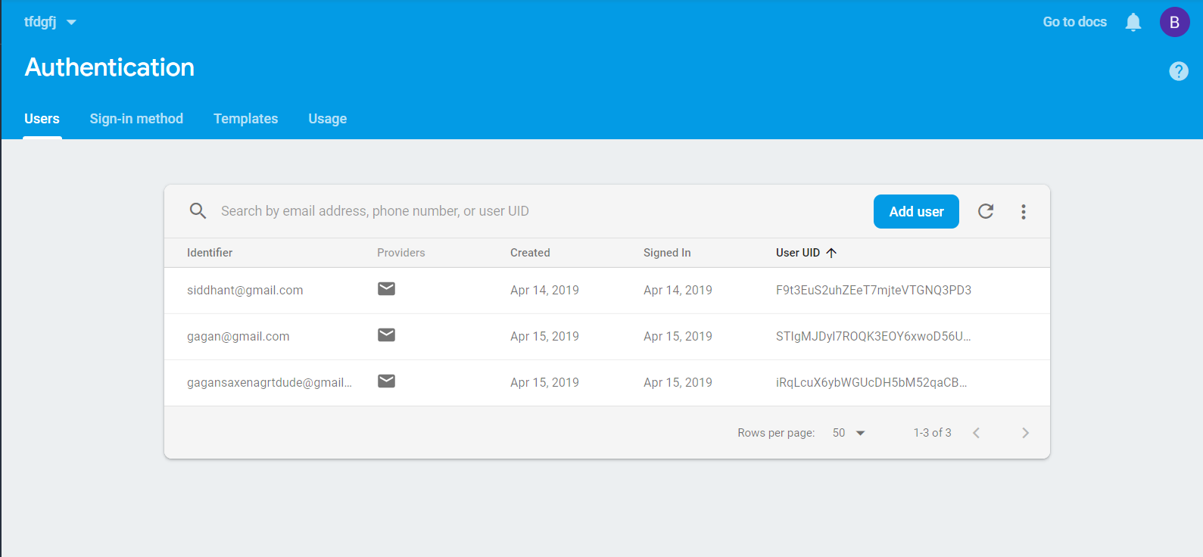

Slide 13
Firebase Realtime Database
Firebase provides a realtime database and backend as a service. The service provides application developers an API that allows application data to be synchronized across clients and stored on Firebase's cloud.
Schema Free.
Firebase simplifies the development process.
In this does not Required SQL queries.
implementation 'com.google.firebase:firebase-database:16.0.4'

Slide 14
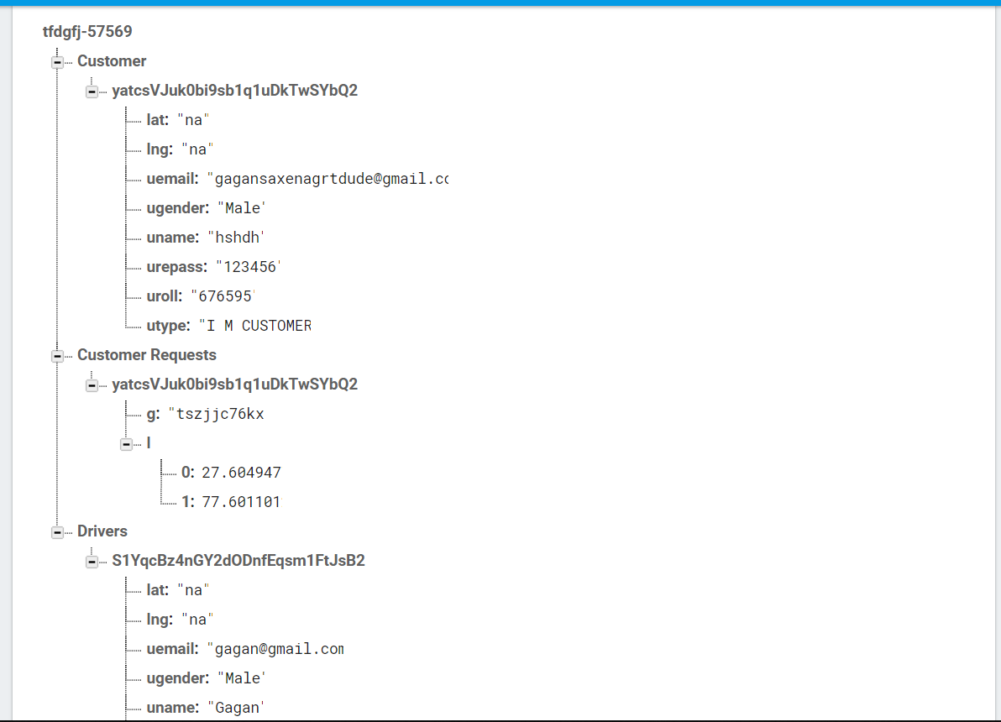

Slide 15

Customer
Driver

Slide 16
Permissions:
INTERNET
ACCESS_NETWORK_STATE
EXTERNAL STORAGE

Slide 17

 http://www.developer.android.com/
 http://www.thenewboston.org/
 http://www.developer.firebase.com/

Slide 18


